Slide 1



PHP Basics
http://pingo.edu.vn/khoa-hoc-php-can-ban/
Web Applications in Hatch
Tuan Duong
http://pingo.edu.vn/tuan-duong/

Slide 2
Contents
What are PHP, CGI and Web Server?
Web applications
Syntax
Variables, variable types
Basic functions
Some predefined variables
Strings escaping
PHP – advantages and disadvantages

Slide 3
What are PHP, CGI and Web Server?

Slide 4
What is PHP?
"PHP Hypertext Preprocessor"
Scripting language
Creation of dynamic content – i.e. HTML
Interaction with databases (CRUDs)
Server side, or via command line (CLI)
Can be embedded in HTML
First introduced in 1995 as module for Apache
Open source, written in C
Similar to Perl and C

Slide 5
What is CGI?
"Common Gateway Interface"
Unified specification for interaction between web server and a CGI program
The CGI program accepts data from the web server and usually returns generated HTML content
CGI programs are used to generate also XML files, images, video streams and any other content, understandable by the browser
The very code of the CGI program is not visible for the client, only it's output

Slide 6
What is web server?
Computer program that is responsible for handling HTTP requests and returning responses
Receives HTTP request
Finds the requested resource or executes CGI program
Returns the resource or program output to the browser
Most common web servers are Apache, IIS, NodeJS, nginx, ligHttpd and others
"LAMP" – Linux, Apache, MySQL, PHP/Perl – the most common software on a web server

Slide 7
Web applications

Slide 8
Web applications
Application that can be accessed over the web
Relies on web servers
Usually written in server-side scripting languages like PHP, Perl, Java, ASP
Has dynamically generated content
Commonly structured as three-tier application - web server, CGI Program (s) and database
Not just web pages

Slide 9
Web applications - Examples
Gmail
SkyDrive / Live.com
Google Office / Windows Office
Prezi
Creately
Slideshare
Almost everything that can be accessed via web browsers ☺

Slide 10
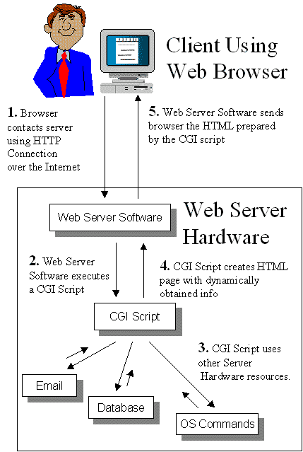
Web application lifecycle

Slide 11
Hello PHP
The PHP code is usually in files with extension ".php"
Can be configured
The PHP code can be nested in the very HTML document
<?php denotes start of PHP code
?> denotes end of PHP code
<html>
<head><title>Hello world page</title></head>
<body>
Hello HTML!
</body>
</html>
<html>
<head><title>Hello world page</title></head>
<body>
<?php print ("Hello PHP!"); ?>
</body>
</html>

Slide 12
Hello PHP – Where to place it ?
In the webroot directory
XAMMP – htdocs/
WAMP – www/
Webroot directory can be configured
Can be accessed via http://localhost/path/to/scriptName.php

Slide 13
Review PHP
PHP is a scripting language commonly used on web servers.
Stands for “PHP: Hypertext Preprocessor”
Open Source
Embedded code
Comparable with ASP
Multiple operating systems/web servers
Notes:
Một scripting language hay script language là một ngôn ngữ lập trình hỗ trợ viết kịch bản (script). Các chương trình được viết cho ngôn ngữ kịch bản có thể được thực thi thông qua lời gọi từ các tác vụ thay vì chạy thủ công bởi người dùng.
Kịch bản có thể được viết và thực hiện "on-the-fly", tức là không cần biên dịch (compile) và liên kết (linked). Khác với các ngôn ngữ thông thường, chương trình viết ra cần biên dịch thành mã máy trước khi đến tay người dùng, chương trình viết bằng ngôn ngữ kịch bản thường được chạy trực tiếp từ mã nguồn hoặc bytecode, do đó người sử dụng hoàn toàn xem và đổi nó mã nguồn của chương trình.

Slide 14
What can PHP do?
Dynamic generation of web-page content
Database interaction
Processing of user supplied data
Email
File handling
Text processing
Network interaction
And more…

Slide 15
Advantages and disadvantages
Advantages
Easy to learn, open source, multiplatform and database support, extensions, community and commercial driven.
Considered to be one of the fastest languages
Disadvantages
Too loose syntax – risk tolerant, poor error handling, poor OOP (before version 6 a lot things are missing!)

Slide 16
Syntax

Slide 17
PHP Syntax
The PHP code starts with <?php and ends with ?>
Depending on server configuration may also start with <? (Short style) – but this is bad practice!
In terms of XML the <?php - ?> part is called "processing instruction"
PHP follows the Perl syntax
Simplified
Procedural (Now has OOP too)
Similar to C and Java

Slide 18
PHP Syntax
PHP Script contains one or more statements
Statement are handed to the PHP Preprocessor one by one
Each statement ends in semicolon ";"
Our first script contains only one statement:
call of the function print
<?php
print ("Hello PHP!"); // this is the statement
?>

Slide 19
PHP Syntax
PHP script can contain unlimited number of statements
Some function can be called without brackets
You can add comments to the code
Starting with "//", "#" or block in "/*" and "*/"
Only "/*" – "*/" can be used over several lines
Comments are NOT executed
<?php
print "<div>";
print "Hello PHP!";
print "</div>";
?>

Slide 20
PHP Syntax
Short opening tag <?=
Forces the result of the expression to be printed to the browser
Similar to print
Allowed to omit ending ";"
<html>
<head><title>Hello world page</title></head>
<body>
<?="Hello PHP!" ?>
</body>
</html>

Slide 21
Preparing to code with PHP
+ Literals
+ Comments
+ Variables, variable types and Constant
+ Basic functions: print, echo,...
+ Strings escaping
+ Expression and Operators
+ Some predefined variables

Slide 22
Literals
String: ‘Hello’ or “Hello”
Number: 45 or 23.456
Boolean: true or false

Slide 23
Comments
// This is a comment
# This is also a comment
/* This is a comment
that is spread over
multiple lines */
Do not nest multi-line comments
// recommended over #

Slide 24
Comments
<?php
// this is a comment
echo ‘Hello World!’;
/* another
multi-line comment */
?>

Slide 25
Variables
When we work in PHP, we often need a labelled place to stor a value (be it a string, number, whatever) so we can use it in multiple places in our script.
These labelled ‘place’ are called VARIABLE

Slide 26
Variables
All variables in PHP start with $ (Perl style)
PHP is "type-less" language
Variables are not linked with type – they can store value with different types
No int a = 5; Just $a = 5;
Each variable is declared when it's first assigned value
This leads to problems due to typing mistakes!
The type of the value determines the type of the variable
<?php // declare string variable $output
$output = "<div>Hello PHP!</div>";
print $output;
?>

Slide 27
Variables
Case sensitive
- $variable differs from $Variable
- Stick to lower-case to be sure!
Name must started with a letter or an underscore

Slide 28
Variables
<?php
$name = ‘A’;
$age = 23;
echo $name;
echo ‘ is ‘;
echo $age;
// A is 23
?>

Slide 29
PHP Variable Types
Possible PHP Variable Types are:
Numeric (real or integer)
The decimal separator is dot ".", not comma ","
Boolean (true or false)
PHP defines the constants as true, TRUE, True and false, FALSE, False
Empty string, zero and some other values are implicitly converted to "false" in boolean expressions
May cause problems when boolean not used properly

Slide 30
Variable variables
PHP supports $$ syntax- variable variables
The variable $str1 is evaluated as 'test' and so $$str1 is evaluated as $test
<?
$str1 = 'test';
$test = 'abc';
echo $$str1; // outputs abc
?>

Slide 31
Constants
Constants (unchangeable variables) can also be defined.
Each constant is given a name (note no preceding dollar is applied here).
By convention, constant names are usually in UPPERCASE.

Slide 32
Constants
In PHP constants are defined with the define function
Cannot change value
Doesn't start with $
Can hold any scalar value
<?
define ('CONSTANT_NAME', 123);
// from here on CONSTANT_NAME will have value 123
print CONSTANT_NAME; // will output 123
?>

Slide 33
Constants
<?php
define(‘NAME’, ‘A’);
define(‘AGE’, 23);
echo NAME;
echo ‘ is ‘;
echo AGE;
// A is 23
?>

Slide 34
Some Basic Functions
We already know print
Similar to print is echo
print_r(array) – prints array with keys and values detailed
phpinfo() – Produces complete page containing information for the server, PHP settings, installed modules, etc
<?
echo "123"; // will output 123 to the browser
?>

Slide 35
Strings Escaping

Slide 36
Strings escaping
Special chars in stings are escaped with backslashes (C style)
The escape sequences for double quoted string:
\n – new line (10 in ASCII)
\r – carriage return (13 in ASCII)
\t – horizontal tab
\v – vertical tab
\\ - backslash
\$ - dollar sign
\" – double quote
$str1 = "this is \"PHP\"";

Slide 37
String escaping
Single-quoted strings escape the same way
Difference is that instead of \" you need \' to escape the closing quotes
No other escaping sequences will be expanded
In both single and double quoted strings, backslash before any other character will be printed too!
$str1 = 'Arnold once said: "I\'ll be back"';

Slide 38
Expressions and Operators
Some type of Operators
Arithmetic
Assignment
Bitwise
Comparision
Ternary
Incrementing / Decrementing
Logical
String

Slide 39
String Operator
Use a dot to concatenate two strings:
$firstname = ‘Nguyen’;
$surname = ‘Van A’;
// displays ‘Nguyen Van A
Echo $firstname.’ ‘.$surname;

Slide 40
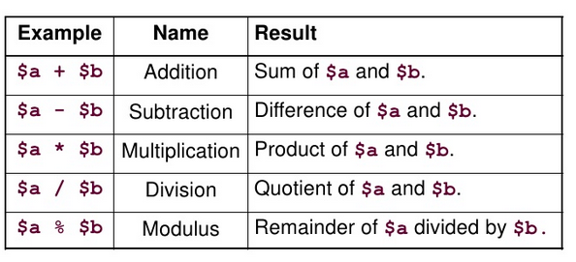
Arithmetic Operators

Slide 41
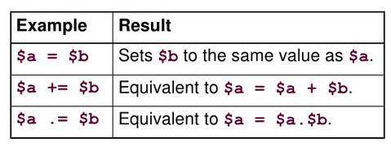
Assignment Operators

Slide 42
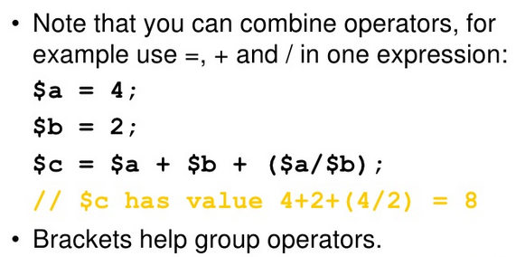
Combining Operators

Slide 43
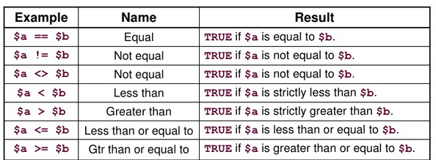
Comparison Operators

Slide 44
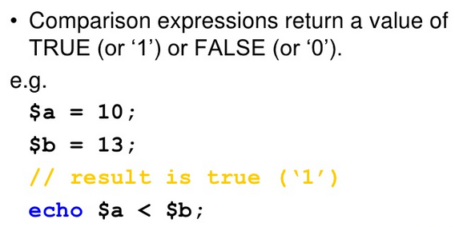
Comparisons

Slide 45
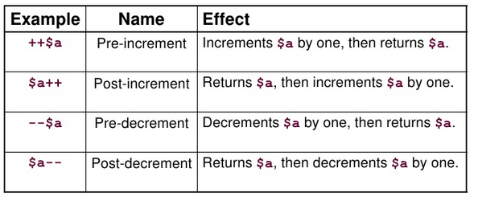
Incrementing / Decrementing

Slide 46
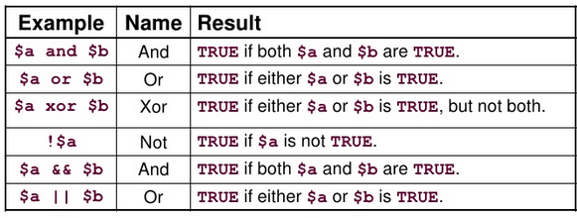
Logical Operators

Slide 47

Ternary Operators

Slide 48

Ternary Operators

Slide 49
PHP Basic Expressions
PHP expressions are similar to C
"=" - assigning value to variable
+, -, /, *, % - arithmetic operations
==, <=, >=, !=, <, > - comparison
+=, -=, /=, *=, %=, ++, --, etc – prefix/postfix operators
( and ) – for expressions combining
&, |, >>, <<, ^, ~ - bitwise operators

Slide 50
PHP Basic Expressions 2
String operators
"." (period) – string concatenating
===, !== comparison
different from ==, !=
"10"==10 will produce true, while "10"===10 will produce false
Strict comparison – $a === $b :
TRUE if $a is equal to $b, and they are of the same type.
Note: Assignment of value to variable returns as result the value being assigned
We can have $a = $b = $c = 7;

Slide 51
Predefined Variables

Slide 52
Predefined Variables
PHP provides a lot predefined variables and constants
__FILE__, __LINE__, __FUNCTION__, __METHOD__, __CLASS__ - contain debug info
PHP_VERSION, PHP_OS, PHP_EOL, DIRECTORY_SEPARATOR, PHP_INT_SIZE and others are provided for easy creating cross-platform applications

Slide 53
Predefined Variables
$_SERVER – array, holding information from the web server – headers, paths and script locations
DOCUMENT_ROOT – the root directory of the site in the web server configuration
SERVER_ADDRESS, SERVER_NAME, SERVER_SOFTWARE, SERVER_PROTOCOL
REMOTE_ADDR, REMOTE_HOST, REMOTE_PORT
PHP_AUTH_USER, PHP_AUTH_PW, PHP_AUTH_DIGEST
And others

Slide 54
Predefined Variables
$_GET, $_POST, $_COOKIE arrays hold the parameters from the URL, from the post data and from the cookies accordingly
$_FILES array holds information for successfully uploaded files over multipart post request
$_SESSION array holds the variables, stored in the session

Slide 55
PHP NULL Value
In PHP there is special value (null) that means that the variable has no value
It is used to express the absence of any data type
Different from "undefined" variable!
Different from empty string or zero
<?
$null_variable = null;
?>

Slide 56
PHP Types
PHP supports "object" variable type
Will be explained further in the OOP lecture
"Resource" variable type
The resource type means the variable is holding reference to resource or data, external to your script
Example – opened file, database connection, etc

Slide 57
PHP Basics

